Slide 1
SYST44998: Wireless Security
Chapter 1: WLAN Security Overview

Slide 2

Outine
Standards organizations
802.11 networking basics
802.11 security basics
802.11 security history

Slide 3
Learning Outcomes
Explain how security information can be gathered using various techniques (1)

Slide 4
Standards Organizations
The Wi-Fi Alliance
International Organization for Standardization (ISO)
Institute of Electrical and Electronics Engineers (IEEE)
Internet Society (ISOC)
Notes:
The Wi-Fi Alliance is a global, nonprofit industry association of about 600 member companies devoted to promoting the growth of WLANs.
The International Organization for Standardization (ISO) created the Open Systems Interconnection (OSI) model, which is an architectural model for data communications. The Institute of Electrical and Electronics Engineers (IEEE) creates standards for compatibility and coexistence between networking equipment, not just wireless networking equipment. However, in this book we are concerned primarily with its role in wireless networking and more specifically wireless security. The Internet Engineering Task Force (IETF) is responsible for creating Internet standards. Many of these standards are integrated into the wireless networking and security protocols and standards. ISO is not a mistyped acronym. It is a word derived from the Greek word isos, meaning equal. The IEEE’s mission is to “foster technological innovation and excellence for the benefit of humanity.” The Internet Society (ISOC) is made up of several groups as you see in this slide.

Slide 5

Standards Organizations
Wi-Fi Alliance
Global, nonprofit industry association of about 600 member companies
Devoted to promoting the growth of WLANs
Responsible for ensuring the interoperability of WLAN products by providing certification testing
Notes:
The Wi-Fi Alliance is a global, nonprofit industry association of about 600 member companies devoted to promoting the growth of WLANs.
The International Organization for Standardization (ISO) created the Open Systems Interconnection (OSI) model, which is an architectural model for data communications. The Institute of Electrical and Electronics Engineers (IEEE) creates standards for compatibility and coexistence between networking equipment, not just wireless networking equipment. However, in this book we are concerned primarily with its role in wireless networking and more specifically wireless security. The Internet Engineering Task Force (IETF) is responsible for creating Internet standards. Many of these standards are integrated into the wireless networking and security protocols and standards. ISO is not a mistyped acronym. It is a word derived from the Greek word isos, meaning equal. The IEEE’s mission is to “foster technological innovation and excellence for the benefit of humanity.” The Internet Society (ISOC) is made up of several groups as you see in this slide.

Slide 6
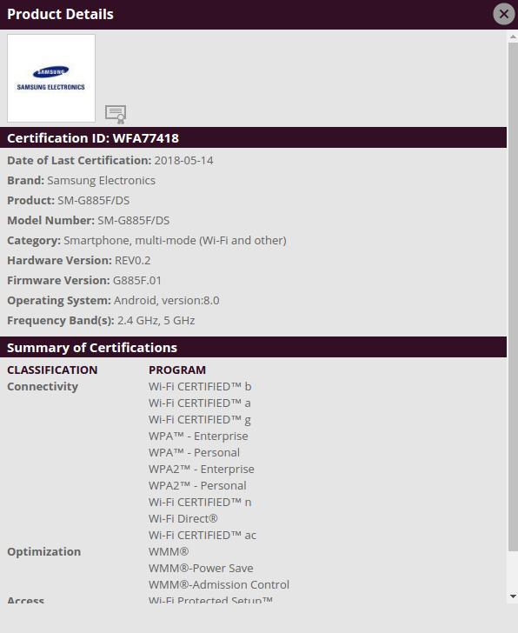
https://www.androidheadlines.com/2018/05/alleged-galaxy-a8-star-gets-certified-by-the-wi-fi-alliance.html
Notes:
The Wi-Fi Alliance is a global, nonprofit industry association of about 600 member companies devoted to promoting the growth of WLANs.
The International Organization for Standardization (ISO) created the Open Systems Interconnection (OSI) model, which is an architectural model for data communications. The Institute of Electrical and Electronics Engineers (IEEE) creates standards for compatibility and coexistence between networking equipment, not just wireless networking equipment. However, in this book we are concerned primarily with its role in wireless networking and more specifically wireless security. The Internet Engineering Task Force (IETF) is responsible for creating Internet standards. Many of these standards are integrated into the wireless networking and security protocols and standards. ISO is not a mistyped acronym. It is a word derived from the Greek word isos, meaning equal. The IEEE’s mission is to “foster technological innovation and excellence for the benefit of humanity.” The Internet Society (ISOC) is made up of several groups as you see in this slide.

Slide 7

Standards Organizations
International Organization for Standardization (ISO)
Created the Open Systems Interconnection (OSI) model
OSI is an architectural model for data communications.
Notes:
The Wi-Fi Alliance is a global, nonprofit industry association of about 600 member companies devoted to promoting the growth of WLANs.
The International Organization for Standardization (ISO) created the Open Systems Interconnection (OSI) model, which is an architectural model for data communications. The Institute of Electrical and Electronics Engineers (IEEE) creates standards for compatibility and coexistence between networking equipment, not just wireless networking equipment. However, in this book we are concerned primarily with its role in wireless networking and more specifically wireless security. The Internet Engineering Task Force (IETF) is responsible for creating Internet standards. Many of these standards are integrated into the wireless networking and security protocols and standards. ISO is not a mistyped acronym. It is a word derived from the Greek word isos, meaning equal. The IEEE’s mission is to “foster technological innovation and excellence for the benefit of humanity.” The Internet Society (ISOC) is made up of several groups as you see in this slide.

Slide 8
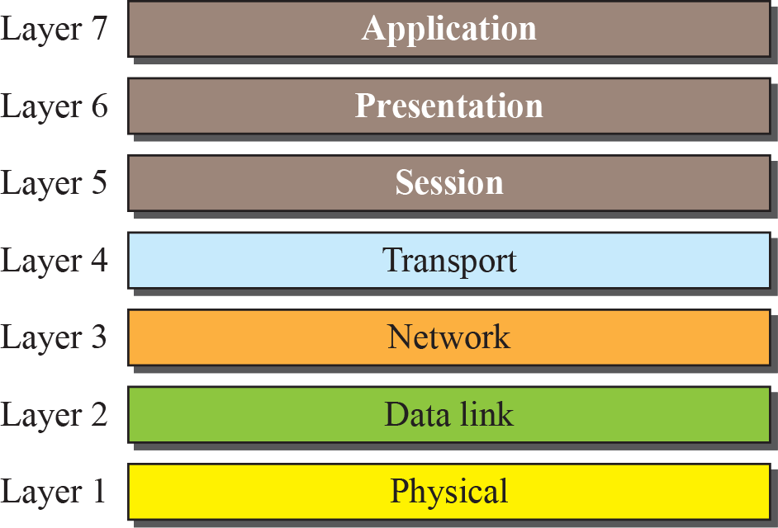
Standards Organizations
OSI Model
Notes:
The Wi-Fi Alliance is a global, nonprofit industry association of about 600 member companies devoted to promoting the growth of WLANs.
The International Organization for Standardization (ISO) created the Open Systems Interconnection (OSI) model, which is an architectural model for data communications. The Institute of Electrical and Electronics Engineers (IEEE) creates standards for compatibility and coexistence between networking equipment, not just wireless networking equipment. However, in this book we are concerned primarily with its role in wireless networking and more specifically wireless security. The Internet Engineering Task Force (IETF) is responsible for creating Internet standards. Many of these standards are integrated into the wireless networking and security protocols and standards. ISO is not a mistyped acronym. It is a word derived from the Greek word isos, meaning equal. The IEEE’s mission is to “foster technological innovation and excellence for the benefit of humanity.” The Internet Society (ISOC) is made up of several groups as you see in this slide.

Slide 9

Standards Organizations
Institute of Electrical and Electronics Engineers (IEEE)
Create standards for compatibility and coexistence between networking equipment
Not just wireless networking equipment
Mission is to “foster technological innovation and excellence for the benefit of humanity.”
Notes:
The Wi-Fi Alliance is a global, nonprofit industry association of about 600 member companies devoted to promoting the growth of WLANs.
The International Organization for Standardization (ISO) created the Open Systems Interconnection (OSI) model, which is an architectural model for data communications. The Institute of Electrical and Electronics Engineers (IEEE) creates standards for compatibility and coexistence between networking equipment, not just wireless networking equipment. However, in this book we are concerned primarily with its role in wireless networking and more specifically wireless security. The Internet Engineering Task Force (IETF) is responsible for creating Internet standards. Many of these standards are integrated into the wireless networking and security protocols and standards. ISO is not a mistyped acronym. It is a word derived from the Greek word isos, meaning equal. The IEEE’s mission is to “foster technological innovation and excellence for the benefit of humanity.” The Internet Society (ISOC) is made up of several groups as you see in this slide.

Slide 10
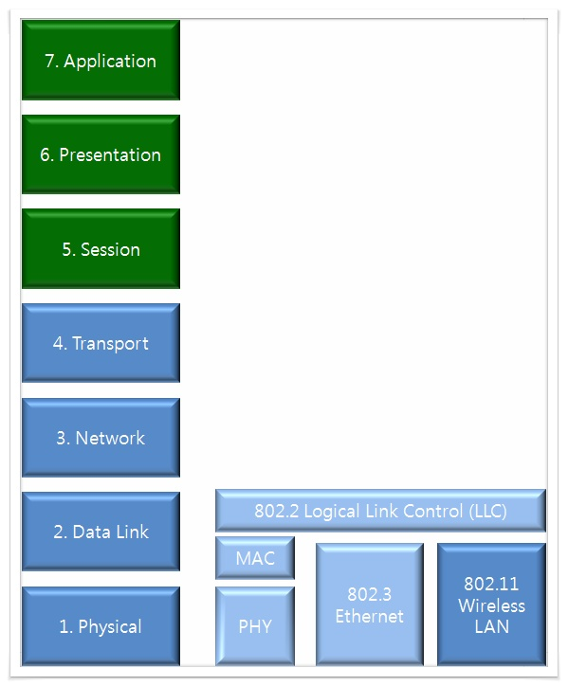
IEEE & OSI Model
https://t1.daumcdn.net/cfile/tistory/2169FB3D559179C720
Notes:
The Wi-Fi Alliance is a global, nonprofit industry association of about 600 member companies devoted to promoting the growth of WLANs.
The International Organization for Standardization (ISO) created the Open Systems Interconnection (OSI) model, which is an architectural model for data communications. The Institute of Electrical and Electronics Engineers (IEEE) creates standards for compatibility and coexistence between networking equipment, not just wireless networking equipment. However, in this book we are concerned primarily with its role in wireless networking and more specifically wireless security. The Internet Engineering Task Force (IETF) is responsible for creating Internet standards. Many of these standards are integrated into the wireless networking and security protocols and standards. ISO is not a mistyped acronym. It is a word derived from the Greek word isos, meaning equal. The IEEE’s mission is to “foster technological innovation and excellence for the benefit of humanity.” The Internet Society (ISOC) is made up of several groups as you see in this slide.

Slide 11
Standards Organizations
Internet Society (ISOC)
RFC 3935
“…to produce high quality, relevant technical and engineering document. …These documents include protocol standards, best current practices, and informational documents of various kinds.”
Internet Engineering Task Force (IETF)
Internet Architecture Board (IAB)
Internet Corporation for Assigned Names and Numbers (ICANN)
Internet Engineering Steering Group (IESG)
Internet Research Task Force (IRTF)
Notes:
The Wi-Fi Alliance is a global, nonprofit industry association of about 600 member companies devoted to promoting the growth of WLANs.
The International Organization for Standardization (ISO) created the Open Systems Interconnection (OSI) model, which is an architectural model for data communications. The Institute of Electrical and Electronics Engineers (IEEE) creates standards for compatibility and coexistence between networking equipment, not just wireless networking equipment. However, in this book we are concerned primarily with its role in wireless networking and more specifically wireless security. The Internet Engineering Task Force (IETF) is responsible for creating Internet standards. Many of these standards are integrated into the wireless networking and security protocols and standards. ISO is not a mistyped acronym. It is a word derived from the Greek word isos, meaning equal. The IEEE’s mission is to “foster technological innovation and excellence for the benefit of humanity.” The Internet Society (ISOC) is made up of several groups as you see in this slide.

Slide 12
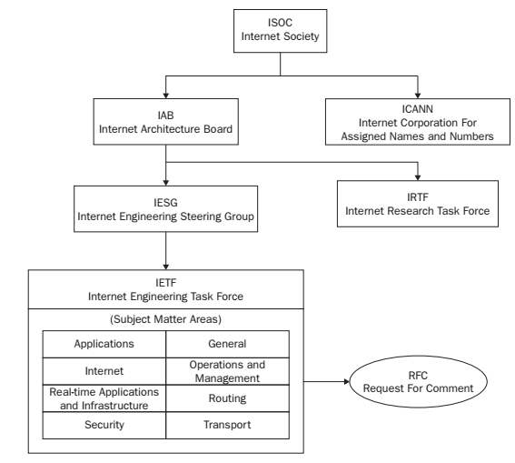
Notes:
The Wi-Fi Alliance is a global, nonprofit industry association of about 600 member companies devoted to promoting the growth of WLANs.
The International Organization for Standardization (ISO) created the Open Systems Interconnection (OSI) model, which is an architectural model for data communications. The Institute of Electrical and Electronics Engineers (IEEE) creates standards for compatibility and coexistence between networking equipment, not just wireless networking equipment. However, in this book we are concerned primarily with its role in wireless networking and more specifically wireless security. The Internet Engineering Task Force (IETF) is responsible for creating Internet standards. Many of these standards are integrated into the wireless networking and security protocols and standards. ISO is not a mistyped acronym. It is a word derived from the Greek word isos, meaning equal. The IEEE’s mission is to “foster technological innovation and excellence for the benefit of humanity.” The Internet Society (ISOC) is made up of several groups as you see in this slide.

Slide 13
802.11 Networking Basics
The OSI Model
TCP/IP
Routing
Switching
A solid understanding of networking fundamentals is mandatory for an understanding 802.11 networking and security.
Notes:
Students will need a solid understanding of Networking in general to be able to better understand 802.11 networking and security.

Slide 14
802.11 Security Basics
Data privacy
Authentication, authorization, and accounting (AAA)
Segmentation
Monitoring
Policy

Slide 15
802.11 Security Basics
Data privacy
For wireless networks, data is transmitted openly and freely, proper protection is needed to ensure privacy
Privacy is achieved by strong encryption

Slide 16
802.11 Security Basics
Data privacy
Encryption technologies
Used to obscure the information
Terminology:
Cipher:
An algorithm used to perform the encryption
Cryptology:
Field of science that covers the encryption & decryption techniques

Slide 17
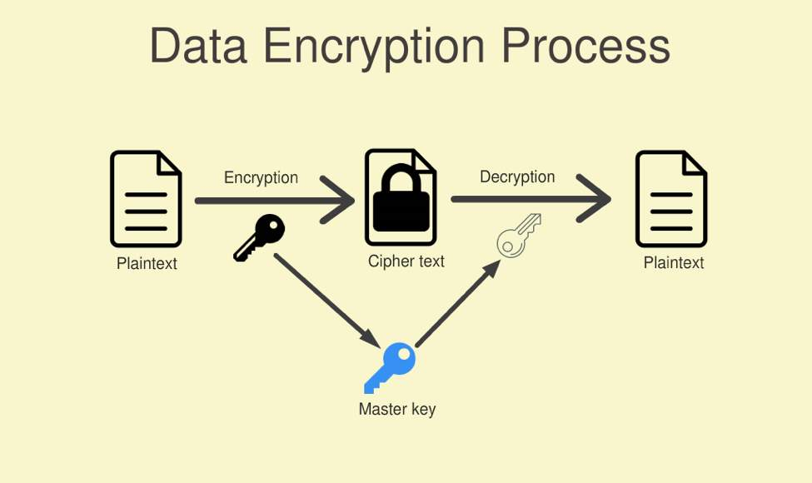
Encryption & decryption processes
http://smartcardpoint.com/all-about-the-data-encryption-process/

Slide 18
802.11 Security Basics
Data privacy
Cryptanalysis: The science of decrypting the cipher-text without the knowledge of the key or cipher

Slide 19
802.11 Security Basics
Authentication, authorization, and accounting (AAA)
Authentication
Verification of user identity and credentials
Users must identify themselves by presenting usernames and passwords, etc.
Multifactor-authentication is the most secure approach.

Slide 20
802.11 Security Basics
Authentication, authorization, and accounting (AAA)
Authorization
Determines if the device or user is authorize to have access to network resources
It might be device-, time-, and location-dependent
It takes place after authentication

Slide 21
802.11 Security Basics
Authentication, authorization, and accounting (AAA)
Accounting
It keeps a historical trail of who used what, when, where, and how.
Keeping an accounting trail is a requirement is most industries.

Slide 22
802.11 Security Basics
Segmentation
Process of separating user traffic within the network
As important as strong encryption and AAA
It can be achieved through the use of routers, VPNs, and VLANs
For 802.11, the most common technique is the creation of WVLANS

Slide 23
802.11 Security Basics
Monitoring
It is important for the sake of
Performance analysis:
Certify that the system is responding as planned
Security analysis
Certify that the system is secure against attacks and intrusion- free

Slide 24
802.11 Security Basics
Monitoring
To monitor malicious wireless activity, wireless IDS and wireless IPS should be used
WIDS and WIPS classify valid and invalid devices on the network
WIPS can also mitigate attacks from rogue AP and rogue users

Slide 25
802.11 Security Basics
Policy
Without security polices any effort to secure the network is worthless.
It must be clearly defined and enforced to solidify the effectiveness of the WLAN security components.

Slide 26
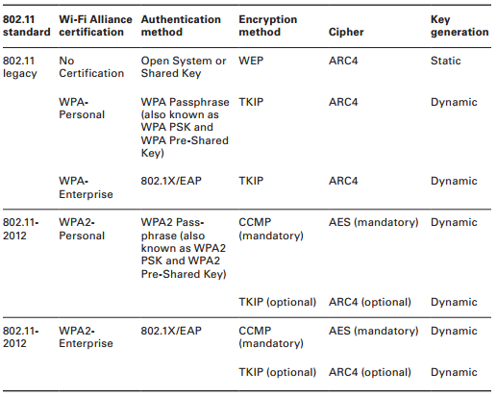
802.11 Security History

